Slide 1
Transverse and Longitudinal Waves

Slide 2

When you have completed this lesson you should be able to:
Define transverse and longitudinal waves.
Understand the terms crest, trough, compression and rarefaction.
Compare and contrast transverse and longitudinal waves.

Slide 3

You should now be familiar with mechanical waves.
A mechanical wave is a wave that requires a medium¹ in order to propagate² and therefore cannot propagate through a vacuum.
¹A medium is a physical substance such as air, water, glass, earth, etc.
²To propagate means to move or travel and is used when describing wave motion.
Mechanical waves can be classified into two different groups: transverse and longitudinal waves. Let's start by discussing transverse waves.

Slide 4
In a transverse wave, the motion of the individual particles in the medium is perpendicular to the motion of the wave.
In the image below is a depiction of a transverse¹ wave. The wave moves left to right in the same direction as the flow of energy, but the particles in the medium move up and down. Thus, the motion of the particles is transverse (or perpendicular) to the motion of the wave and the direction of energy flow.
¹Transverse means "in a cross direction" or "crosswise" so the particles in the wave are moving crosswise to the direction of wave propagation.
Sometimes the motion of particles in the medium is referred to as a temporary displacement of mass as the particles (and their mass) will return to their starting position after the wave motion stops.

Slide 5
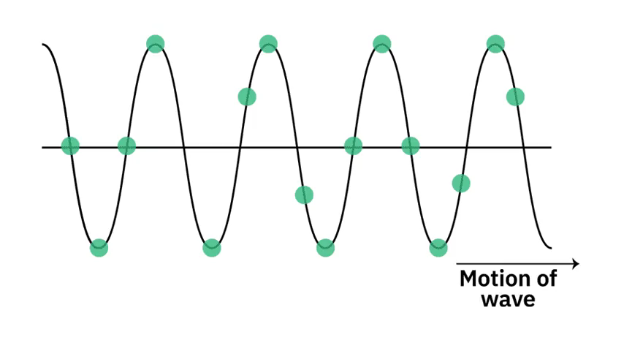

Slide 6
The classic example of a transverse wave is a water wave.
In the animation below we can observe how water waves affect the individual motion of the water particles (the dots). As the water waves travel from the right side of the screen to the left we can see that the individual water particles only move up and down.
Thus, the motion of the particles is perpendicular (or transverse) to the motion of the wave and we are observing a transverse wave.

Slide 7
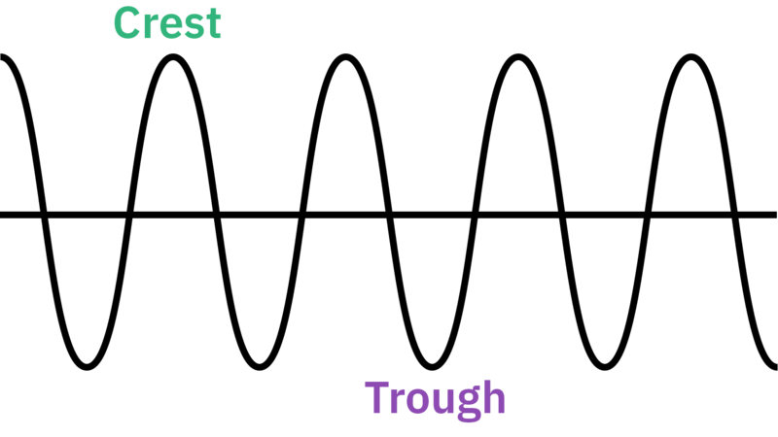
There are two positions of the particle motion within a transverse wave that have a specific term.
When the particles are at the top of their upward motion it is referred to as a crest in the wave. When particles are at the bottom of their downward motion it is referred to as a trough in the wave. These terms have been added to our representation of a transverse wave below.
Both the crest and trough of a wave are points of maximum displacement of the particles (mass) in the medium.

Slide 8
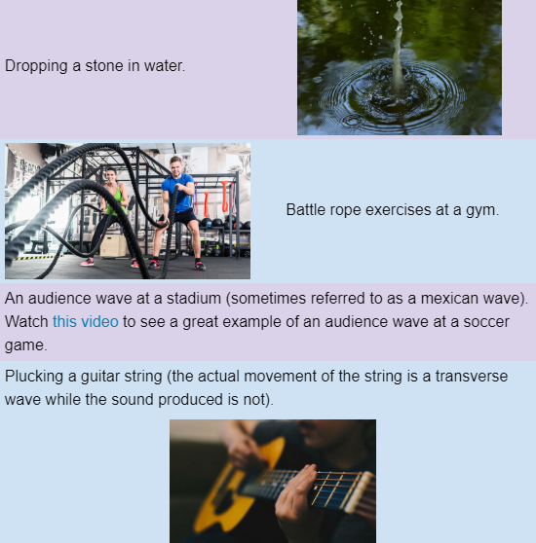
There are many real world examples of transverse waves, some of which are listed in the table below.

Slide 9

In a longitudinal wave, the motion of the individual particles in the medium is parallel to the motion of the wave.
If the longitudinal¹ wave moves left to right (and the energy flows left to right), then the individual particles in the medium vibrate left to right also. But remember that these particles do not travel down the length of the wave, they only experience a temporary displacement of mass as waves cannot transfer matter!
¹Longitudinal means "lengthwise" or "along the length".
Longitudinal waves are often depicted as follows:

Slide 10
The classic example of a longitudinal wave is a sound wave.
A sound wave travelling in air is generated by a vibrating source. As the source moves outward, it creates a region of higher pressure next to the closest air particles which pushes these air particles away. These pushed air particles then create a region of higher pressure next to their neighbouring particles which pushes those air particles and so on.
As the source moves inward, it creates a region of lower pressure next to the closest air particles which pulls them closer. These pulled air particles then create a region of lower pressure next to their neighbouring air particles which pulls those air particles and so on.
Particles will move from higher pressure regions into lower pressure regions.

Slide 11
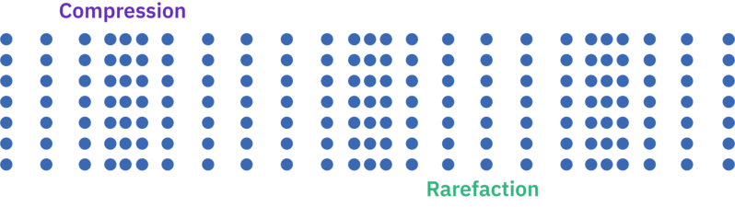
A longitudinal wave propagates by changing the pressure of the medium.
A region where many particles come together and there is higher than normal pressure is referred to as a compression in the wave.
A region where many particles are spread apart and there is lower than normal pressure is referred to as a rarefaction in the wave.

Slide 12
A real world example of longitudinal waves occurs during traffic jams.
Vehicles on the open road have a large amount of space between them. As vehicles approach a traffic jam they slow down and get closer together. This is a compression in the wave of traffic.
At some point one of the vehicles is able to speed up. As this vehicle starts to speed up the vehicle immediately behind it can also start to speed up. However the time delay between the two drivers speeding up means they get further apart and we have a rarefaction in the wave of traffic.

